Slide 1
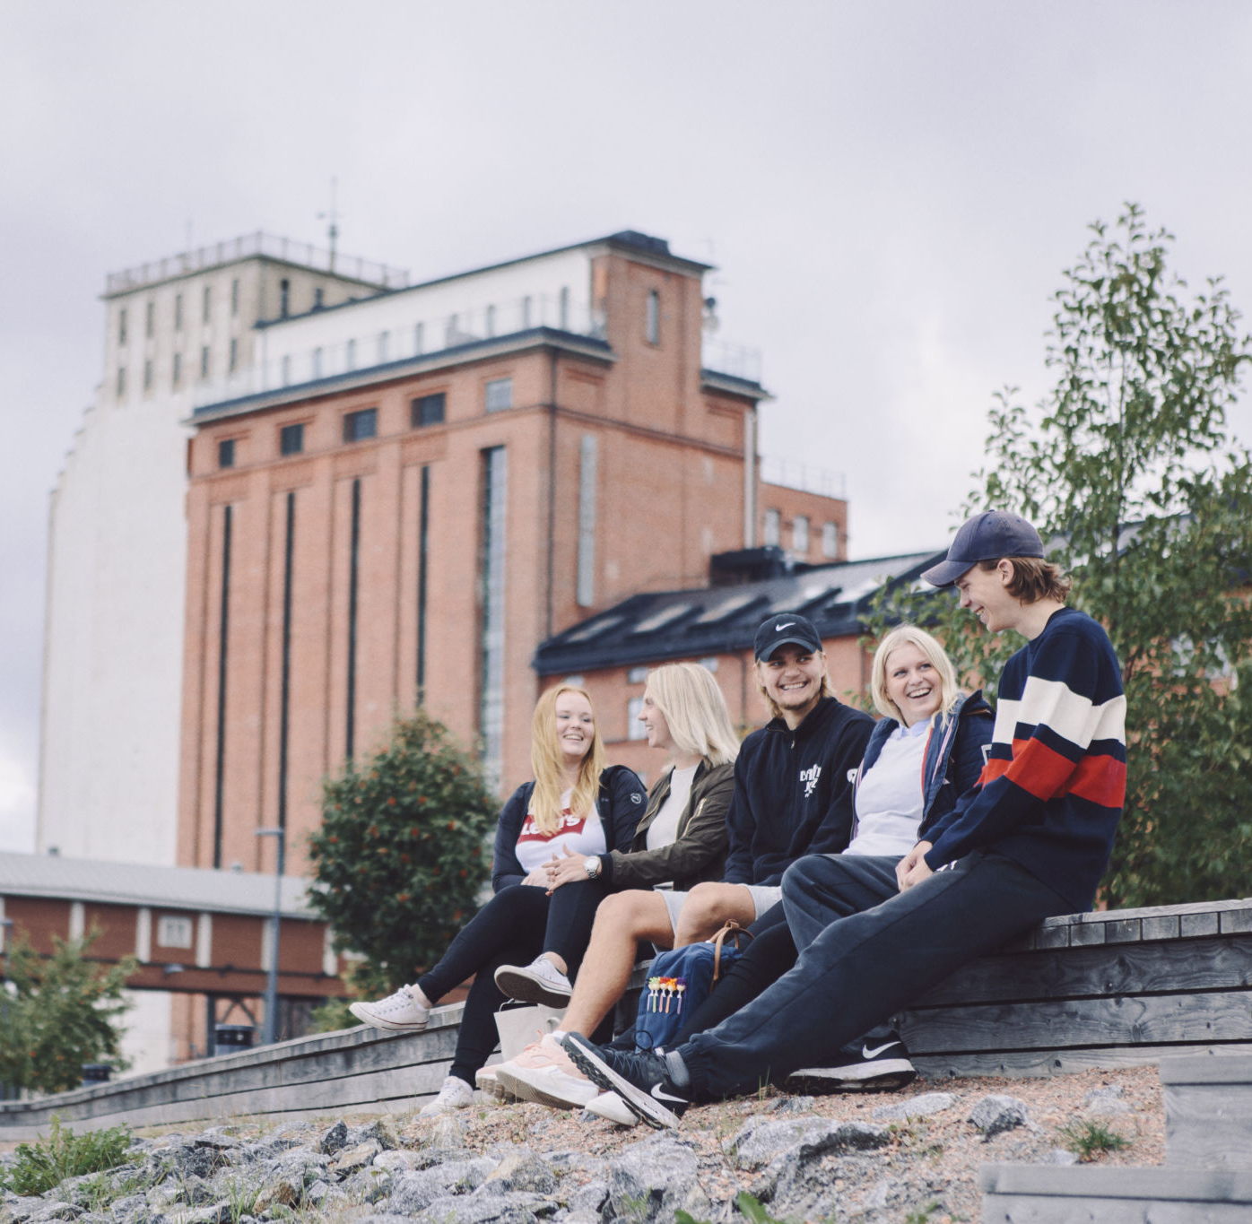
Feel Good at ÅAU
Restroom in F411
Prayer room F207
Bemer-madrass in the restroom, F411
Break Pro - load it down to your own computer for free
Join ÅAU Sports (member-fee)

Slide 2
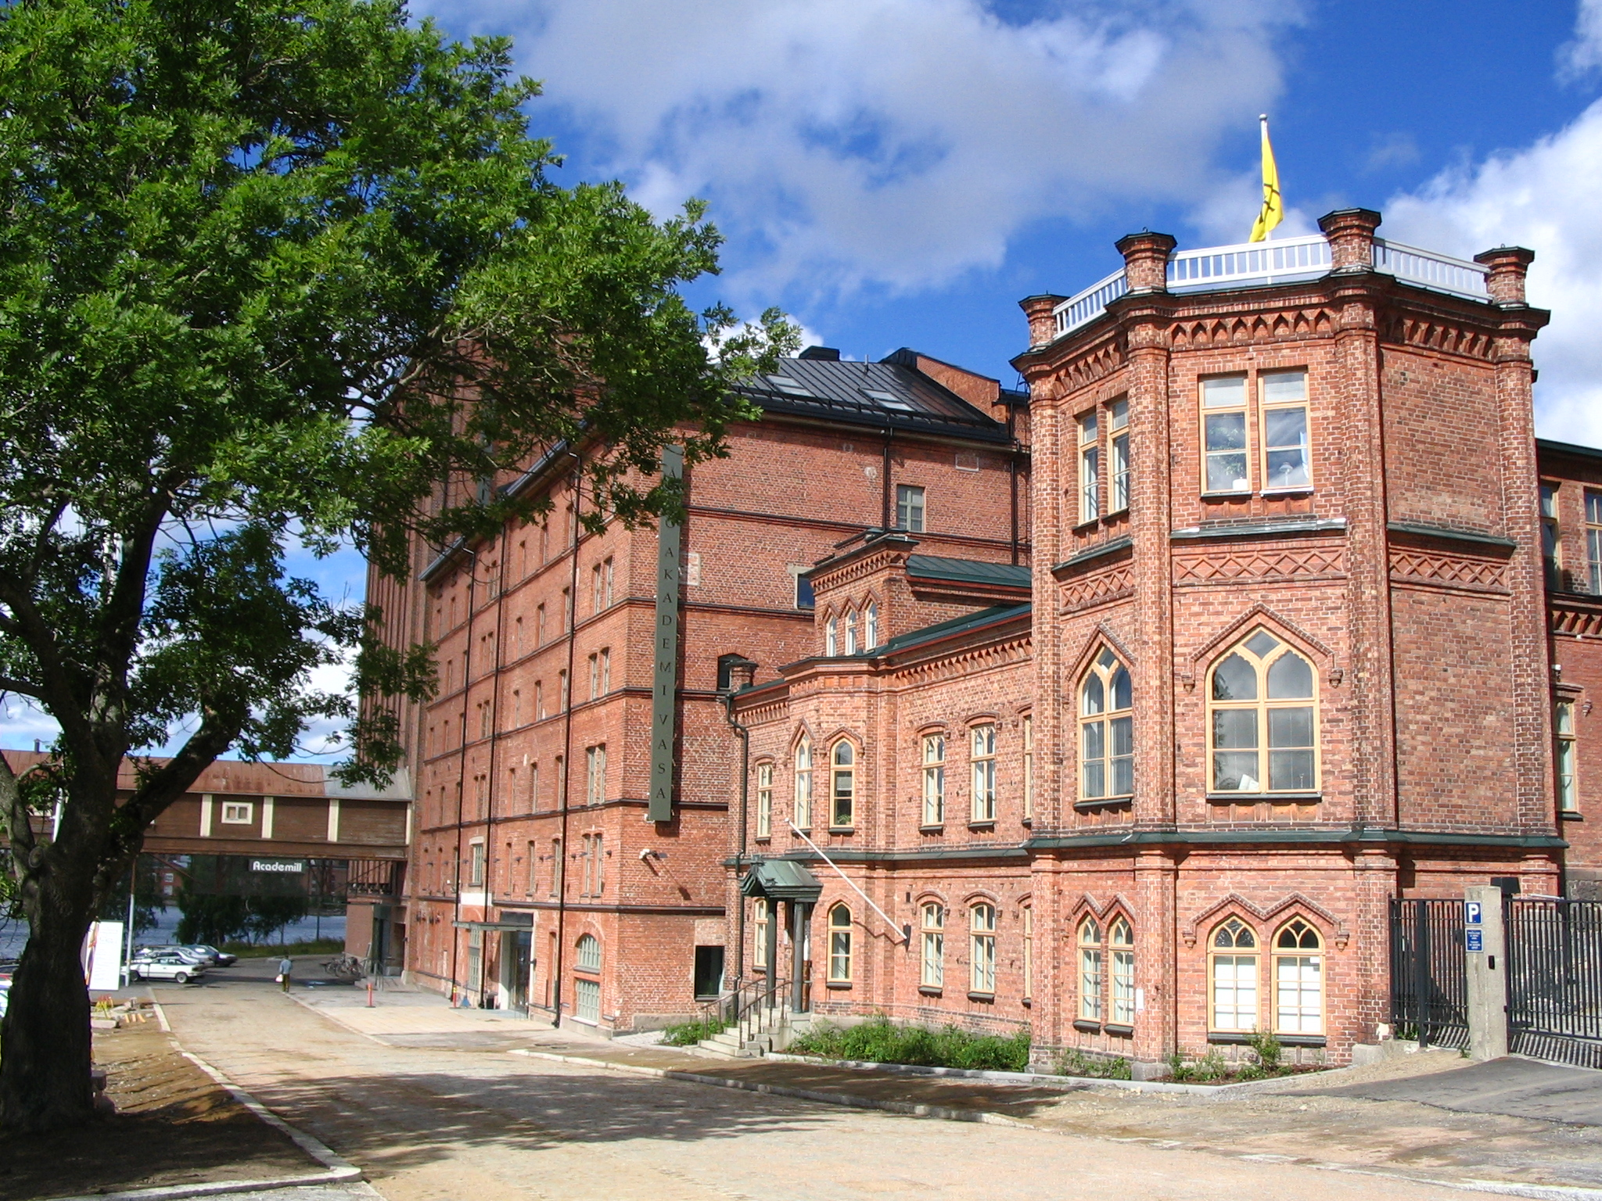

ÅAU Sports
2026-2027

Slide 3

What is and Who can join ÅAU Sports?
an activity organized for students and employees that offers sports, exercise, and trying out activities
All students that studies for bachelor- or masters-exam at Åbo Akademi University
  Novia University of Applied Sciences
  Hanken School of Economics
  All staff at the above Universities

Slide 4
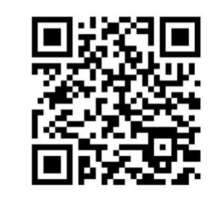
Cost for students
The academic year from the 1st of September – 31st of August 75€
Autumn term 50€
Spring term 55€
Summer 45€
Attention! 15€ for the tag from WSC
Pay your memberfee via QR-code

Slide 5

ÅAU Sports
Shedule 2026-20267
Starts from the 1st of September little by little
Try out sessions at Wasa Sports Club at week 35, 36 and 37. Tuesdays and Fridays at 10am-8pm and Sundays at 4-8pm.

Slide 6

Other benefits read more in
ÅAU Sports blog

Slide 7
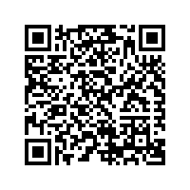
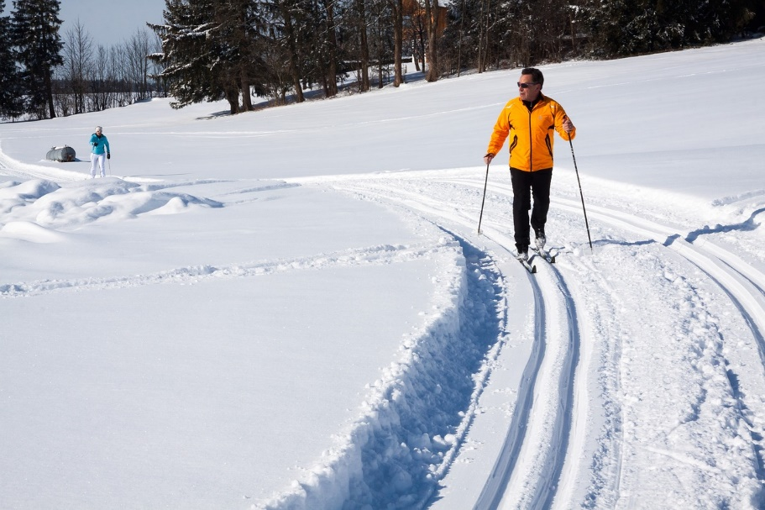
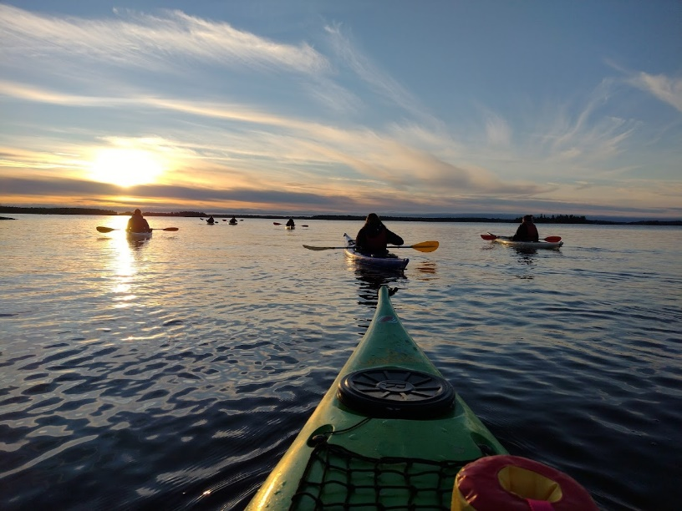
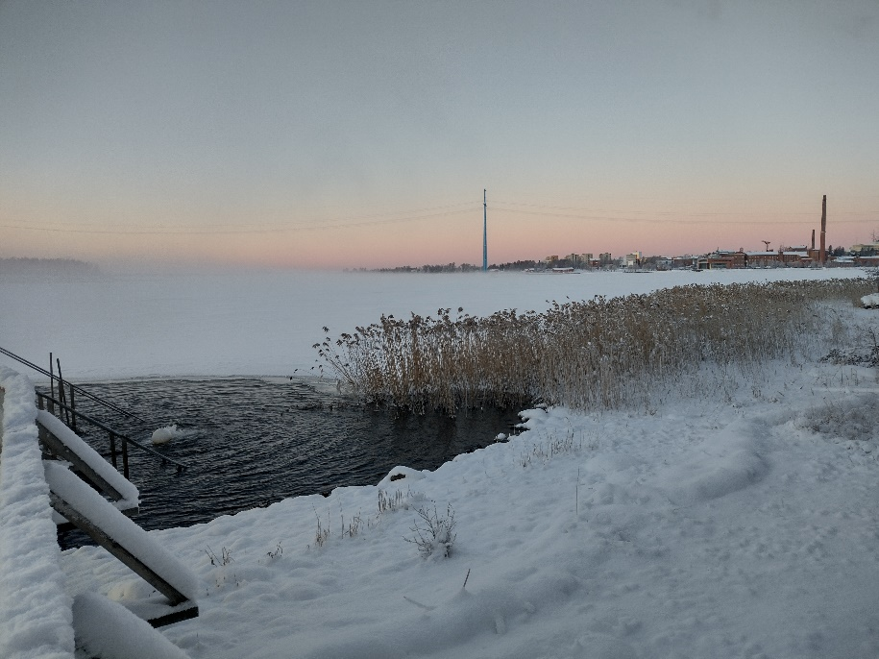
Happenings
We organize different trials-on occasions - you receive information about these, via the mailing list (automatically when you have paid the memberfee) or info at the blog.

Slide 8
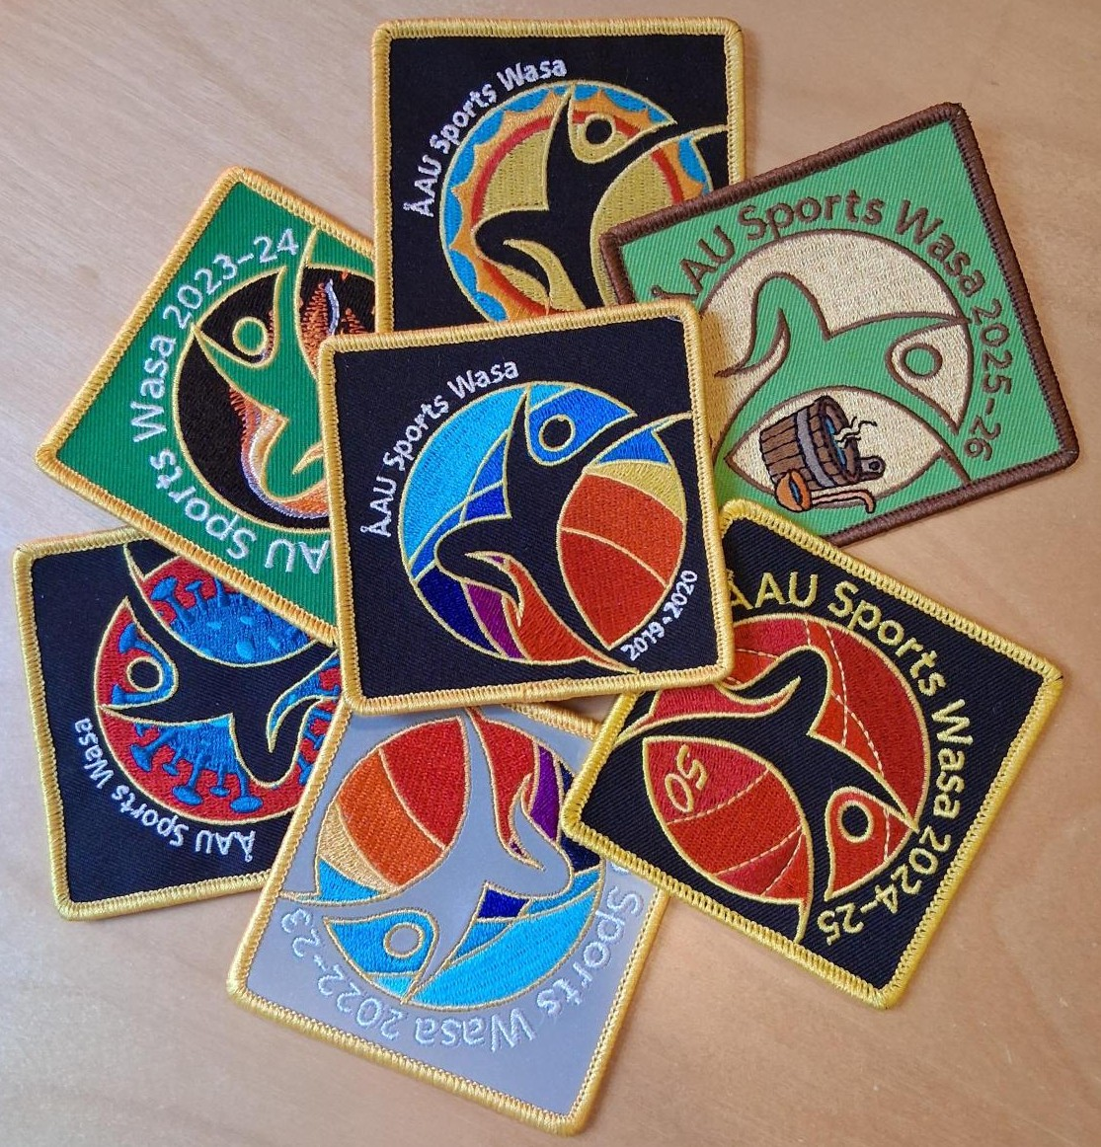
Overall Badge you can buy them when you register or some othertime

Slide 9

Where do I get information?
ÅAU Sports blog
Via mail, when you have registered
Via sport-groups whatsapp-messeges
Instagram

Slide 10
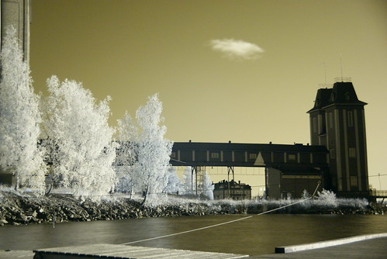
contact
Åbo Akademi, Academill
Strandgatan 2, 65100 Vasa, room F409
06-324 71 61 / 050-36 77 914
aausports@abo.fi
At the office:
Tuesdays at 9am-2:30pm
Wednesdays at 9am-2:30pm
Thursdays at 9:am-2:30pm
Please contact me before!

