Slide 1
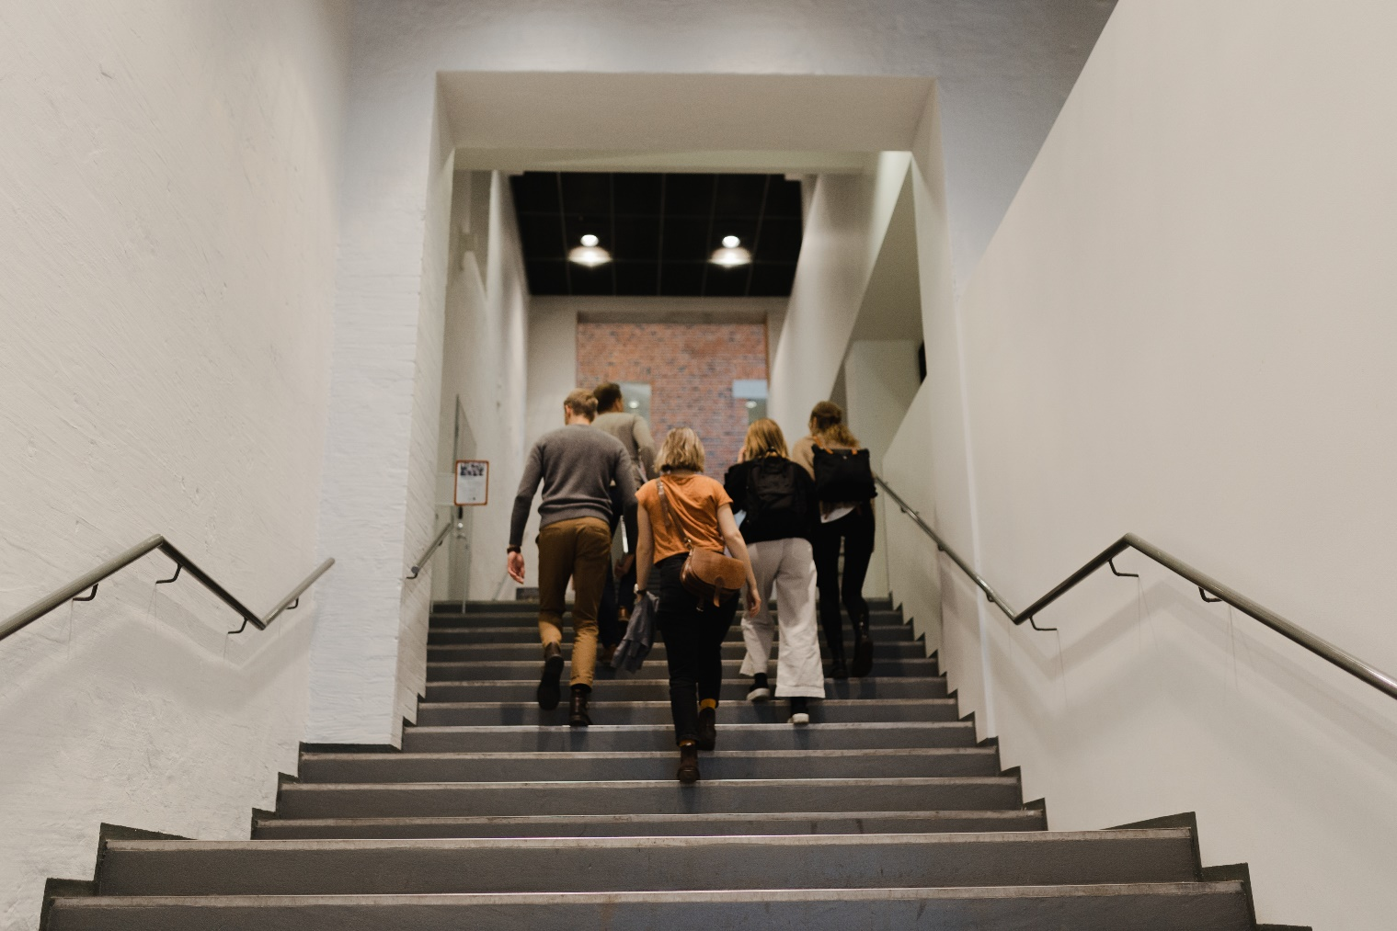
Feel Good at ÅAU
Room for rest and prayer in F207
Bemer-madrass
Break Pro
Join ÅAU Sports

Slide 2
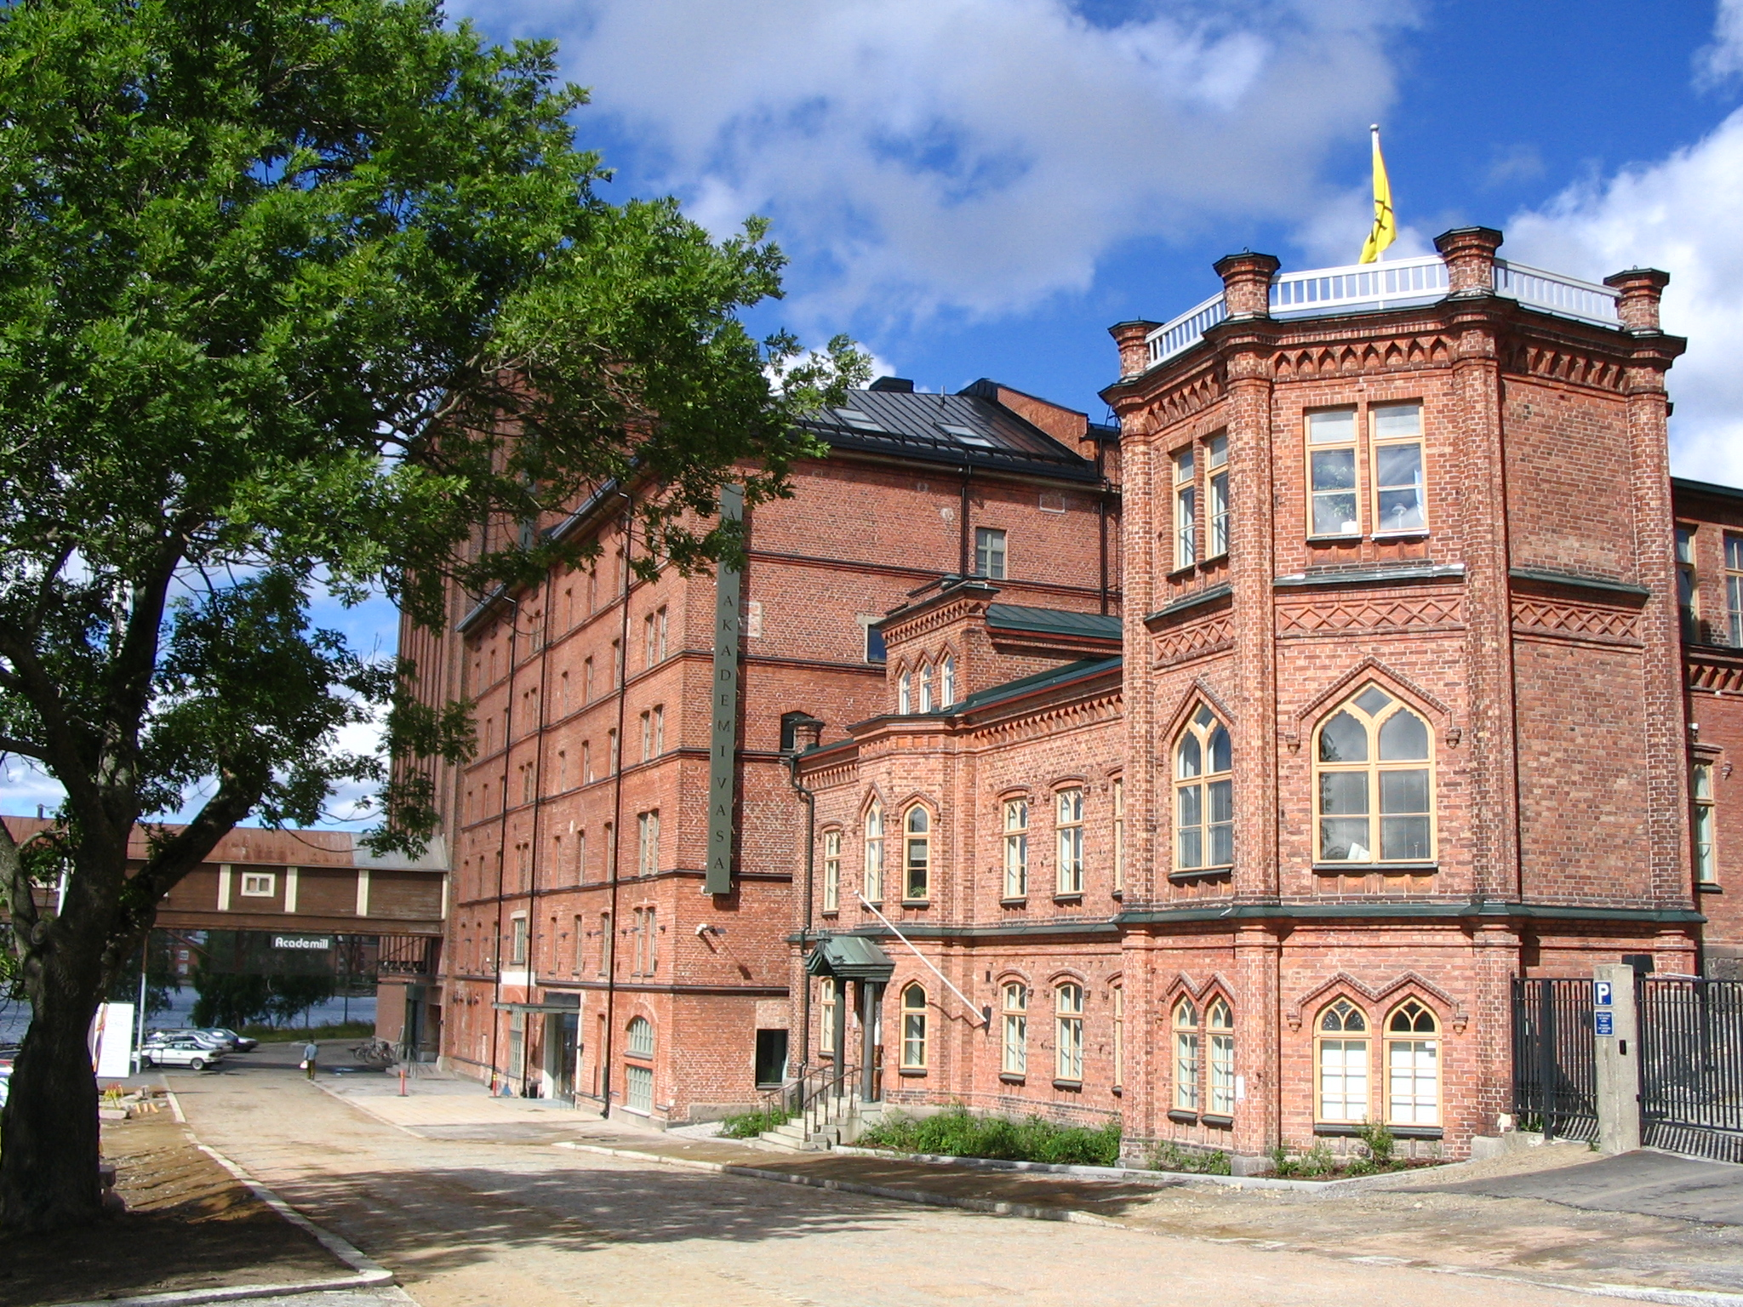

ÅAU Sports
2024-2025

Slide 3

What is ÅAU Sports?
All bachelor or master's degree students and exchange students at
  Åbo Akademi University
  Novia University of Applied Sciences
  Hanken School of Economics
  All staff at the above universities

Slide 4
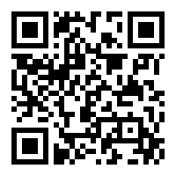
Cost for students
The academic year from the 1st of September – 31st of August 60€
Autumn term 40€
Spring term 45€
Summer 30€
Pay your memberfee via QR-code

Slide 5

ÅAU Sports
Shedule 2024-2025
Starts from week 2 and some activites from week 3 or further on

Slide 6

Other benefits read more in
ÅAU Sports blog

Slide 7
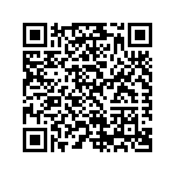
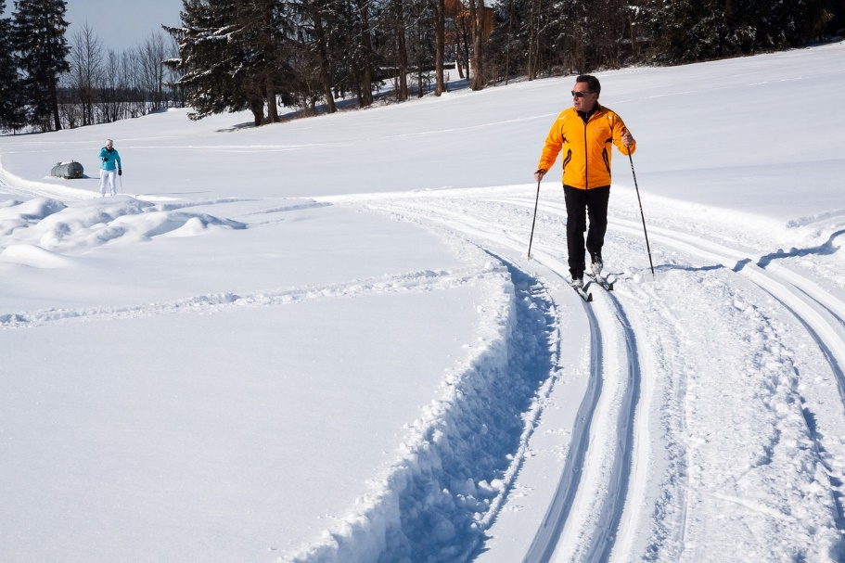
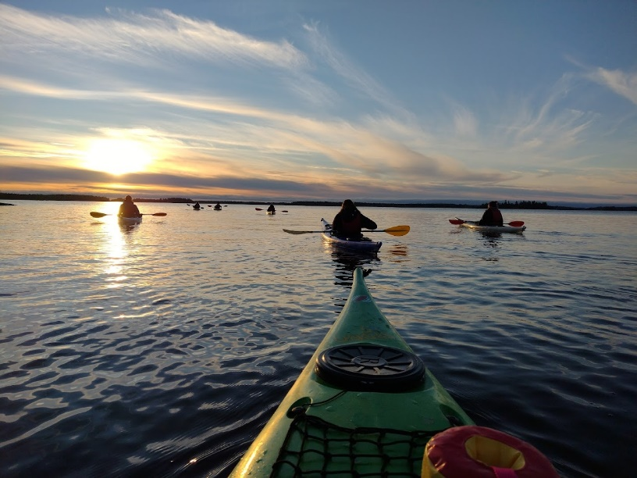
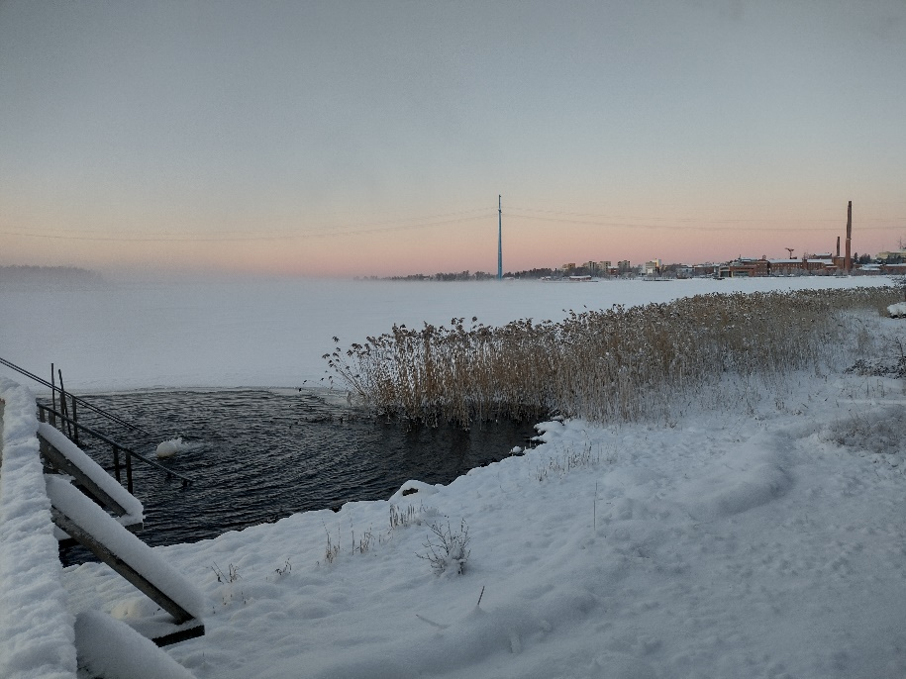
Happenings
We organize different trials-on occasions - you receive information about these, via the mailing list (automatically when you have paid the memberfee) or info at the blog.

Slide 8
Try out
Wasa Move – one free try out oppertunity
Mon: 9-11 / 16-19
Tues: 9-12 / 16-19
Wed: 10-11 / 16-19
Thur: 9-12 / 16-19

Slide 9

Overall Badge
Buy here

Slide 10

Where do I get information?
ÅAU Sports blog
Via mail, when you have registered
Via sport-groups whatsapp-messeges
Instagram

Slide 11

contact
Åbo Akademi, Academill
Strandgatan 2, 65100 Vasa, room B430
06-324 71 61 / 050-36 77 914
astenkul@abo.fi
At the office:
Tuesdays at 9:15am-2:45pm
Wednesdays at 9:15-2:45pm
Thursdays at 9:15-2:45pm

