Slide 1
Exchange tutors 2024-2025 Vasa

Slide 2
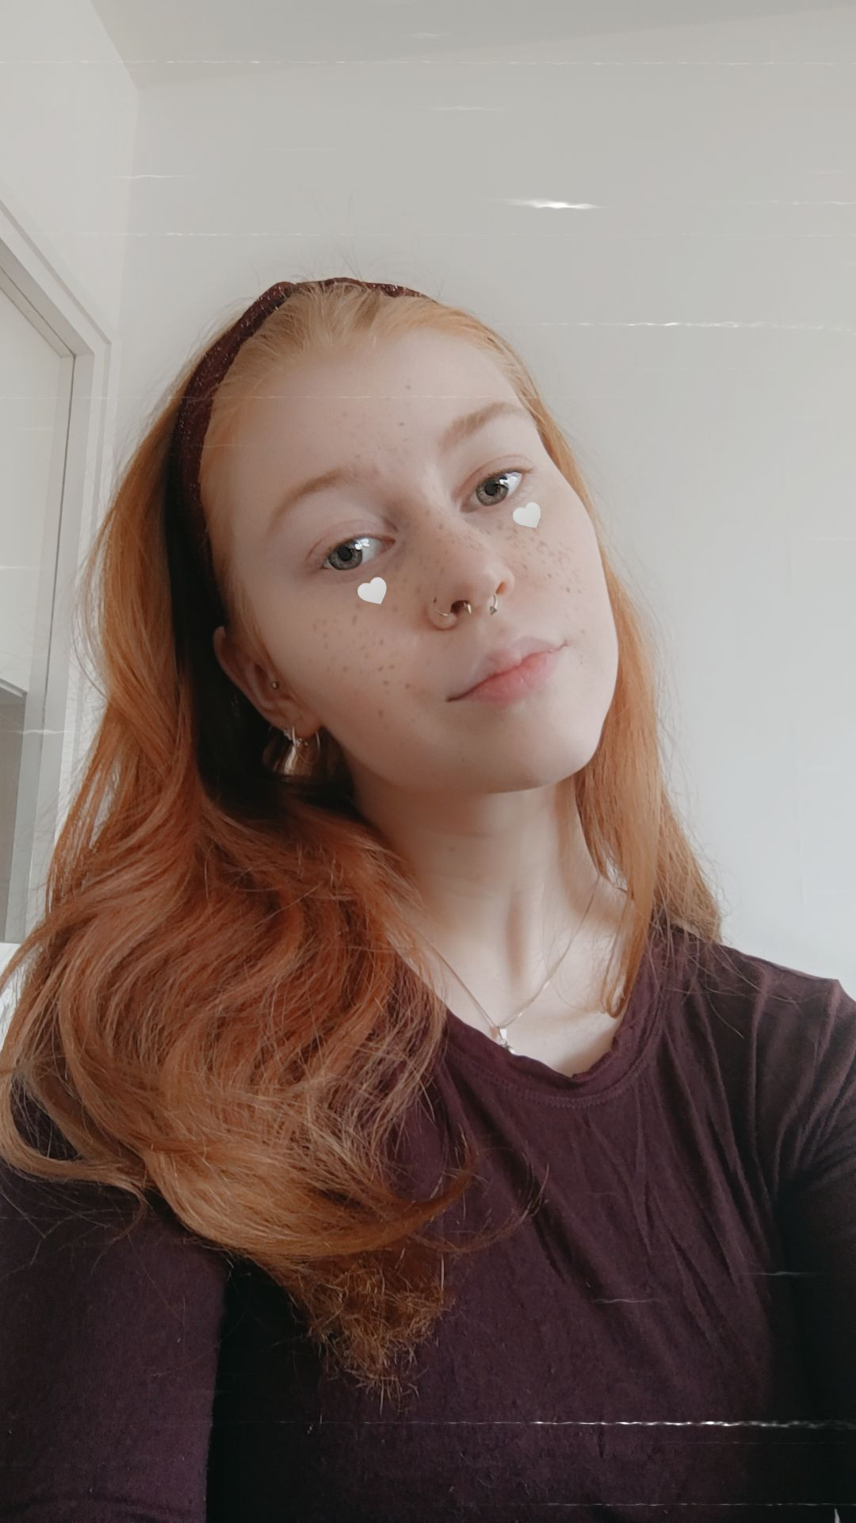
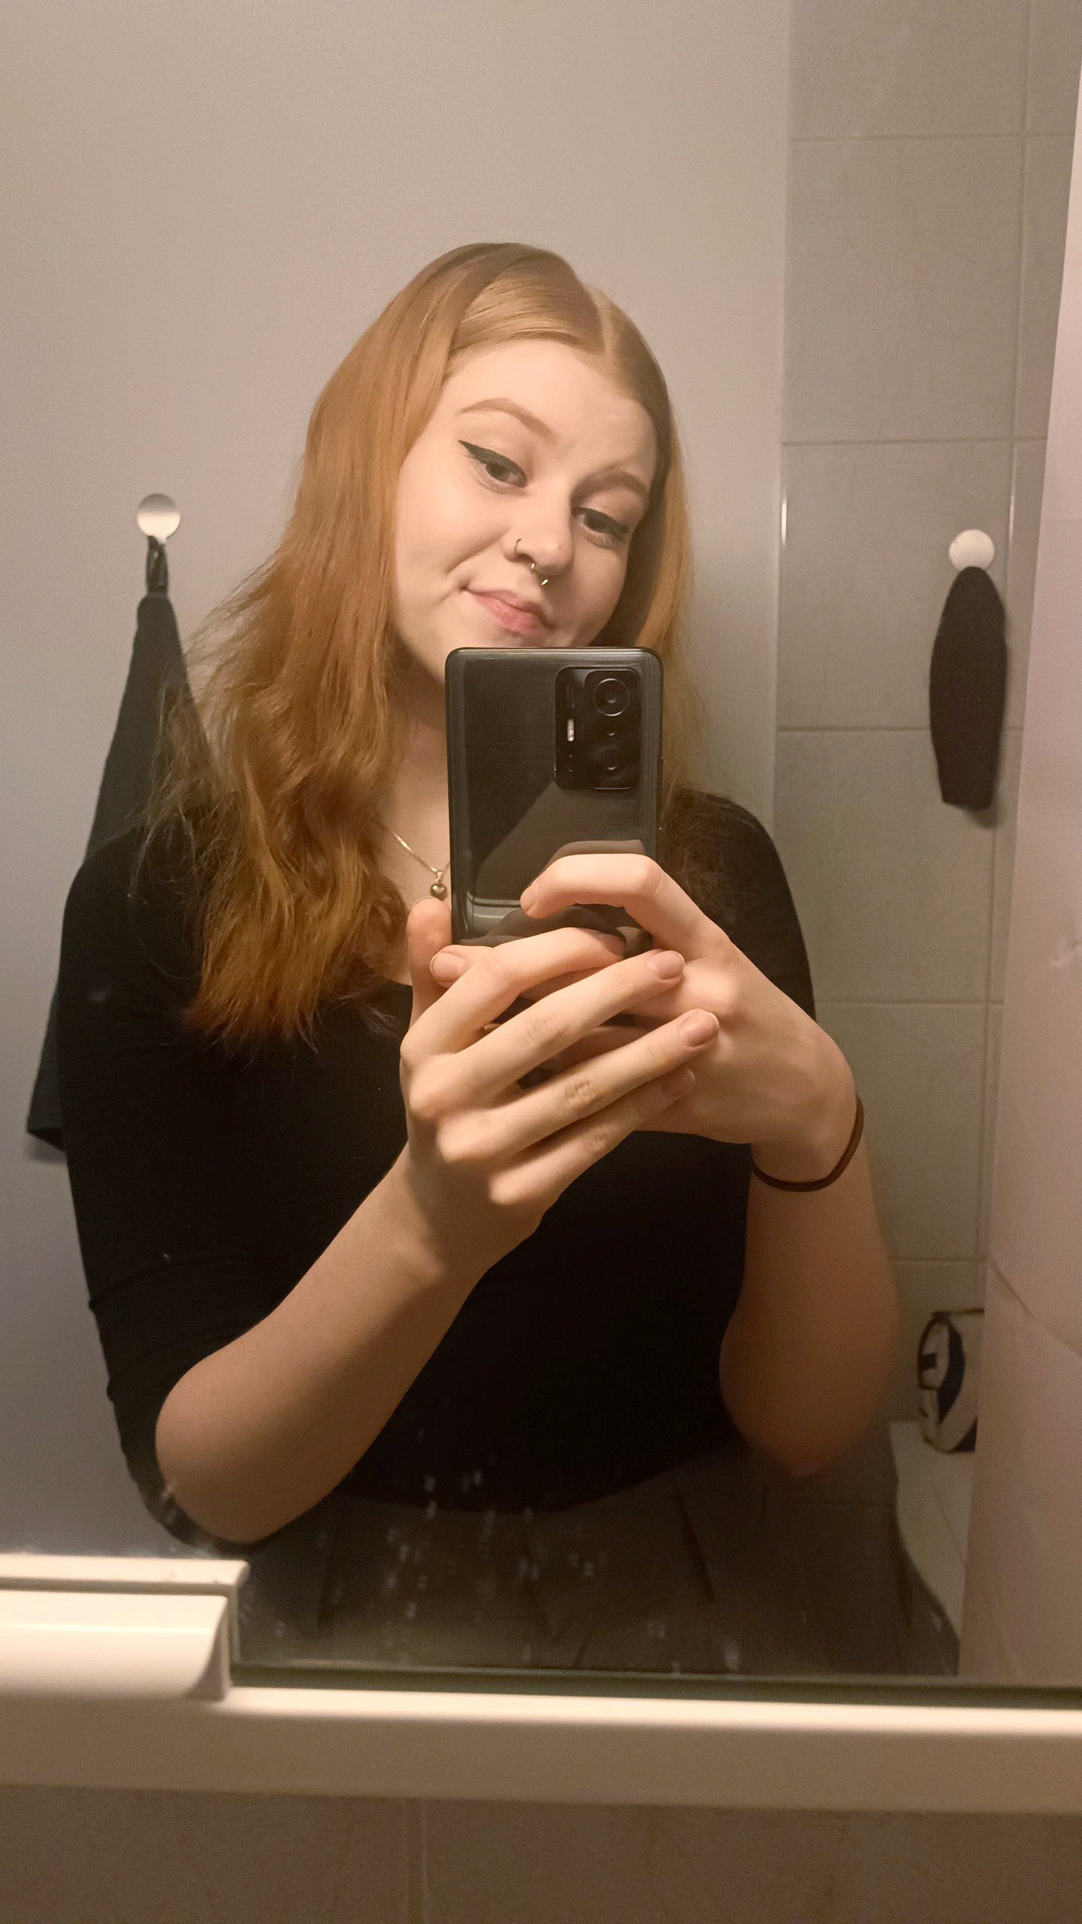
Jenny Ingman
Hi! I'm Jenny,
a 20-year-old redhead, originally from a small, Swedish-speaking village, one hour drive north from Vaasa. I moved here last year to study Social Sciences at Åbo Akademi.
My interests vary from going for a nature walk to going clubbing, doing sports, anything goes and I'm always up for trying new things.
Excited to meet y'all, feel free to take contact:
Snapchat: jenny.ingman04
Instagram: jenny.ingman

Slide 3
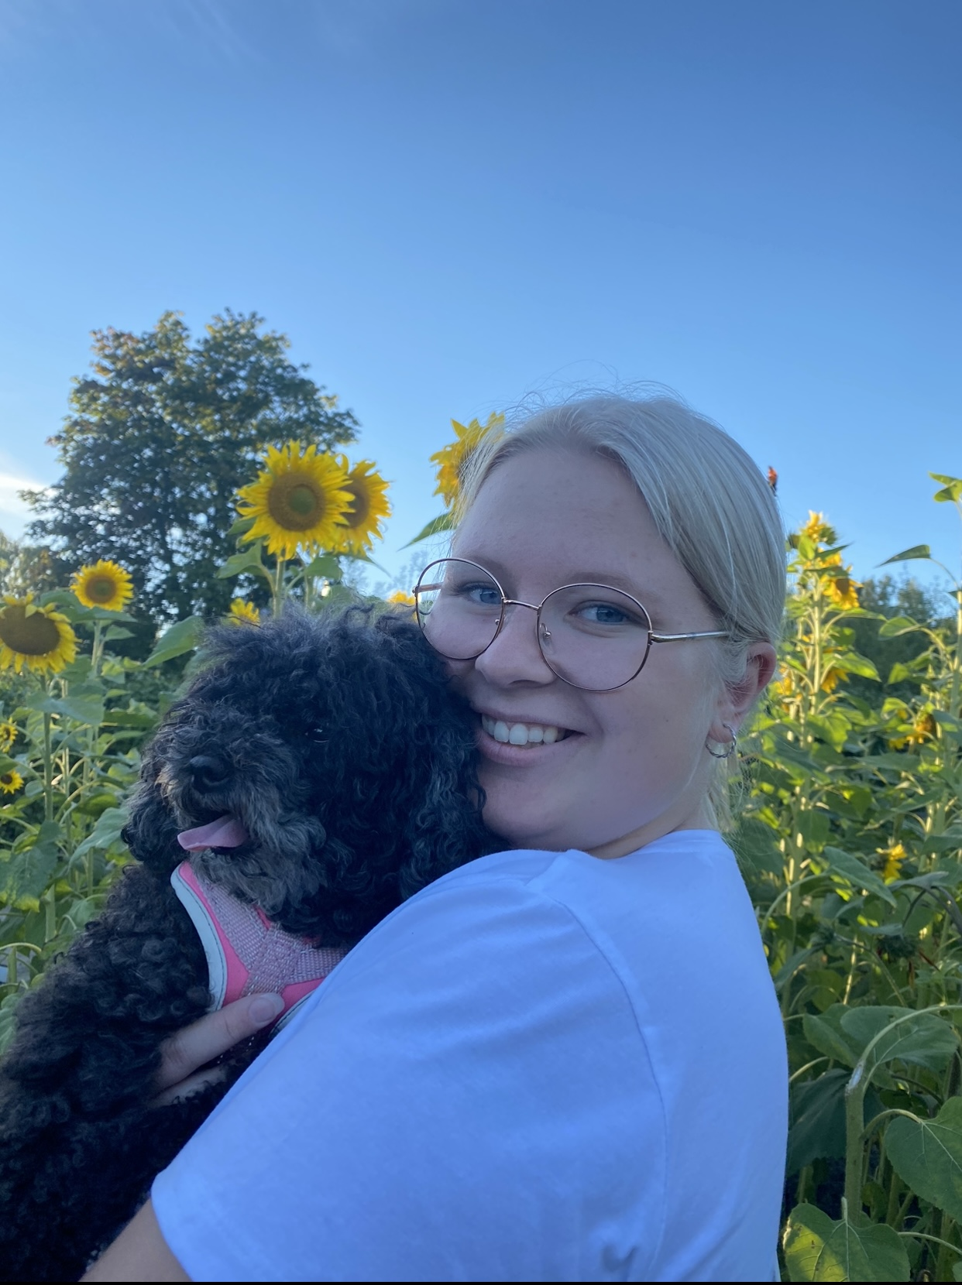
Maya Parkkinen
Hi! My name is Maya and I'm a 21-year-old girl who is studying to become a class teacher. I'm originally from Jakobstad- a small town about an hour from Vasa, but I have been living in Vasa since last year.
On my free time I like to do sports, hang out with my friends and cook. I'm also very interested in traveling and learning languages. I speak Swedish, Finnish, English and French.
I have been on a few shorter exchanges to France, which have been wonderful experiences. I hope you will enjoy your exchange as much as I did!
My Instagram: maya_parkkinen

Slide 4
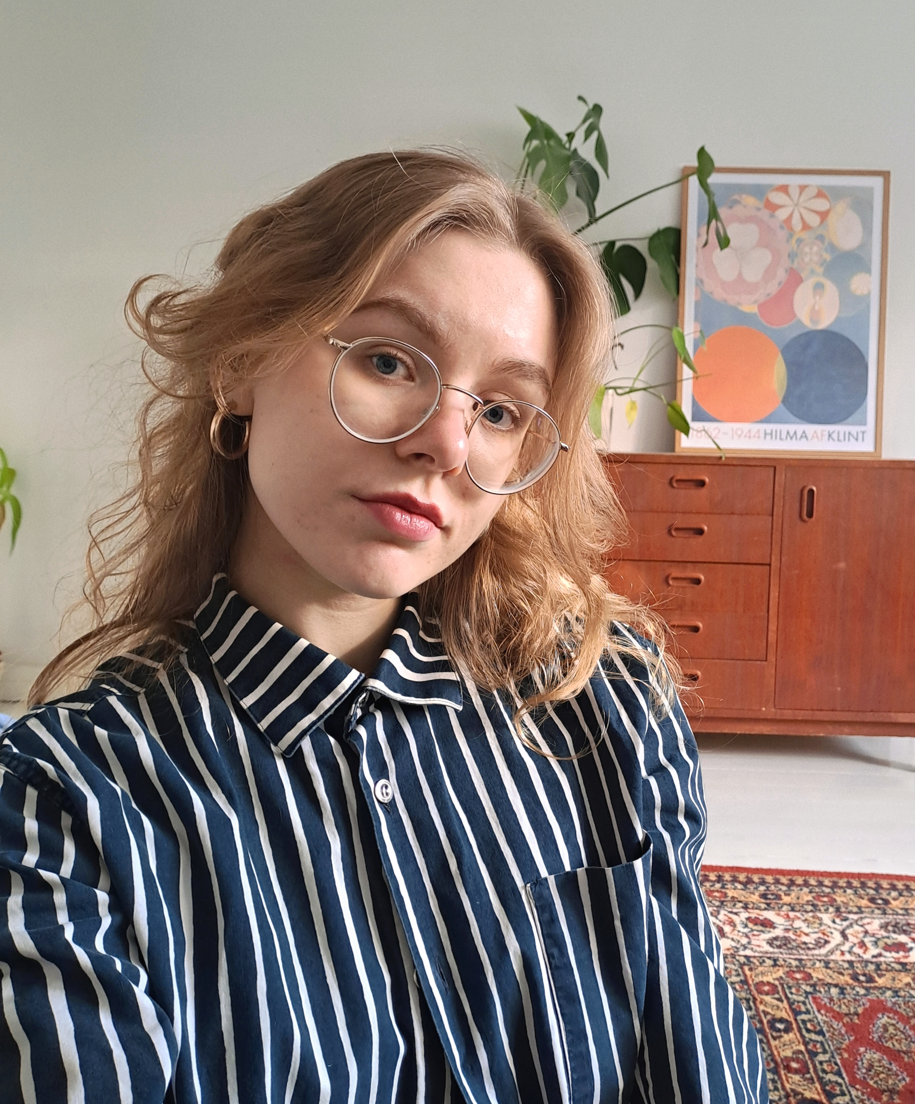
Linnea Wikström
Hi! I’m Linnea, a 23-year-old currently in my fourth year of class teacher studies. I’m originally from a small Swedish-speaking village on the West Coast, but I’ve been enjoying life in Vasa ever since I moved here 2020- and I hope you will like too :) Together we could have picnics by the sea and go second-hand shopping!
In my free time I like to draw, dance, listen to music and read. I find myself the happiest when I’ve got a lot of fun things planned into my calendar!
Truly looking forward to meeting you all <3
Feel free to contact me on Instagram @linneeawikstrom :)

Slide 5
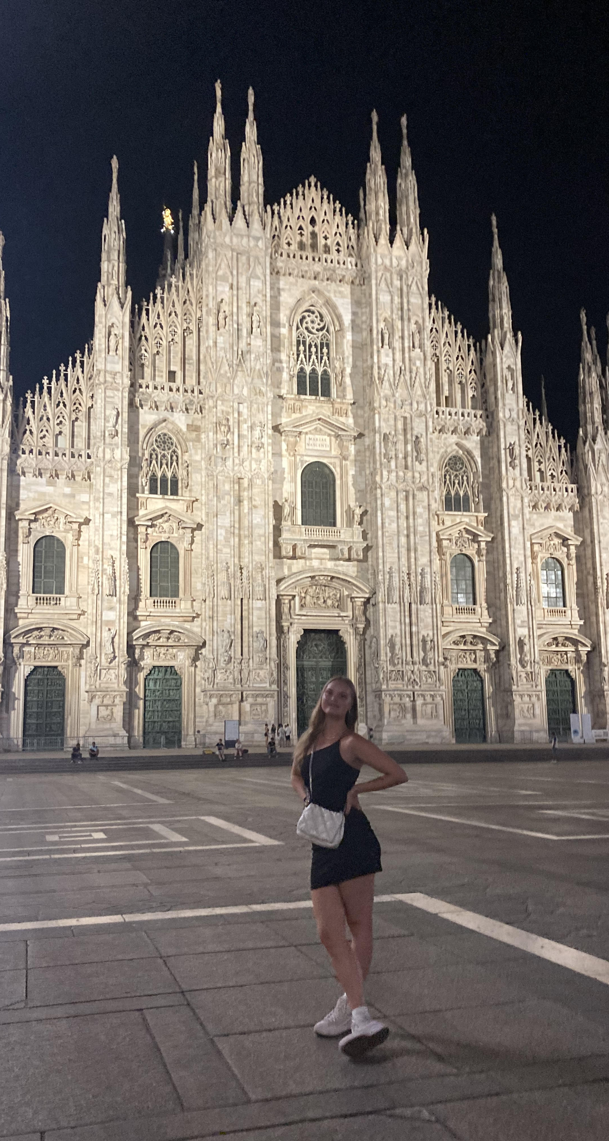
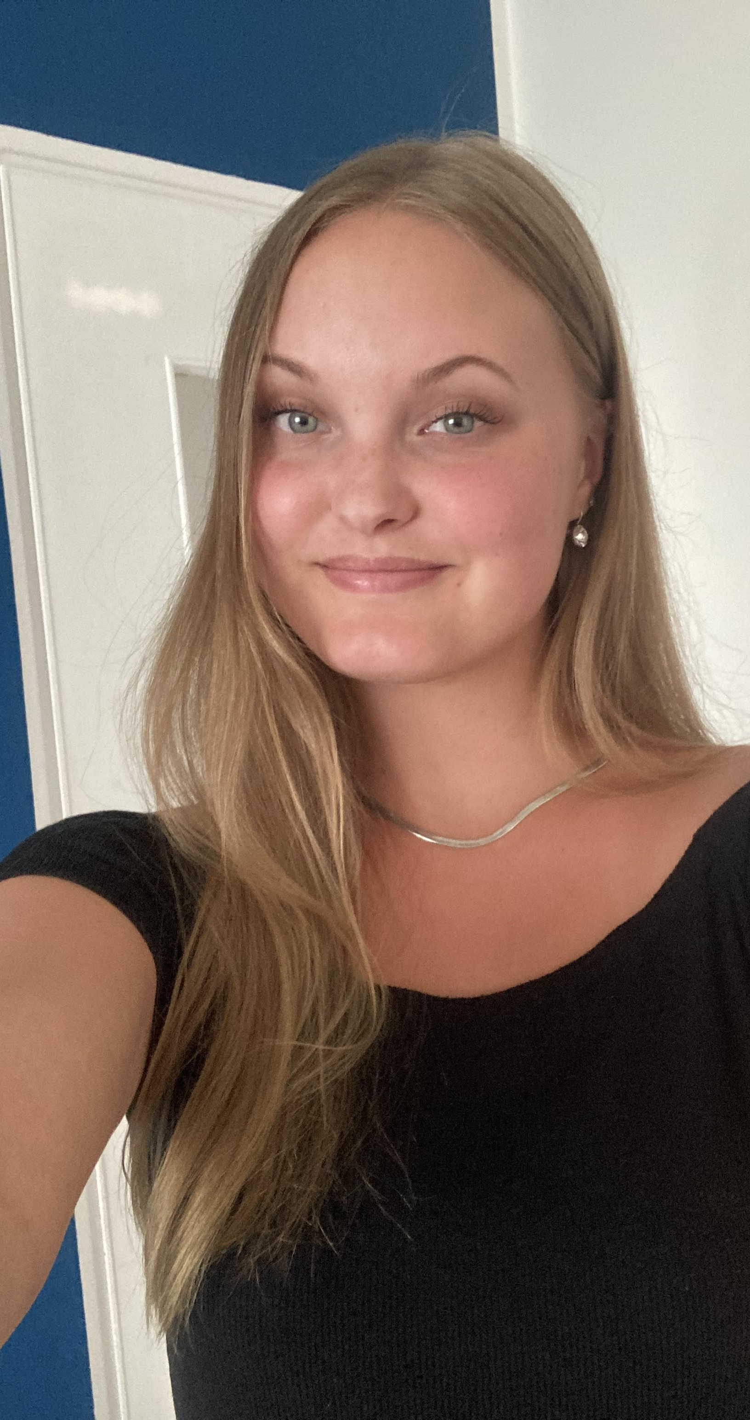
Kajsa Forslund
Hello!
My name is Kajsa Forslund (@kajsasofiaalice on Instagram), I'm 23 years old and I come from a village close to Vaasa. I study social sciences at Åbo Akademi University and I'm currently working on my Master's thesis, which will hopefully be done by next summer. I'm a Swedish-speaking Finn, feminist, traveler and now also an exchange tutor! The most interesting thing about me is probably my exchange, which took place during the spring semester of 2023 in Milan, Italy.
I'm so looking forward to making new memories with you all! :)

Slide 6
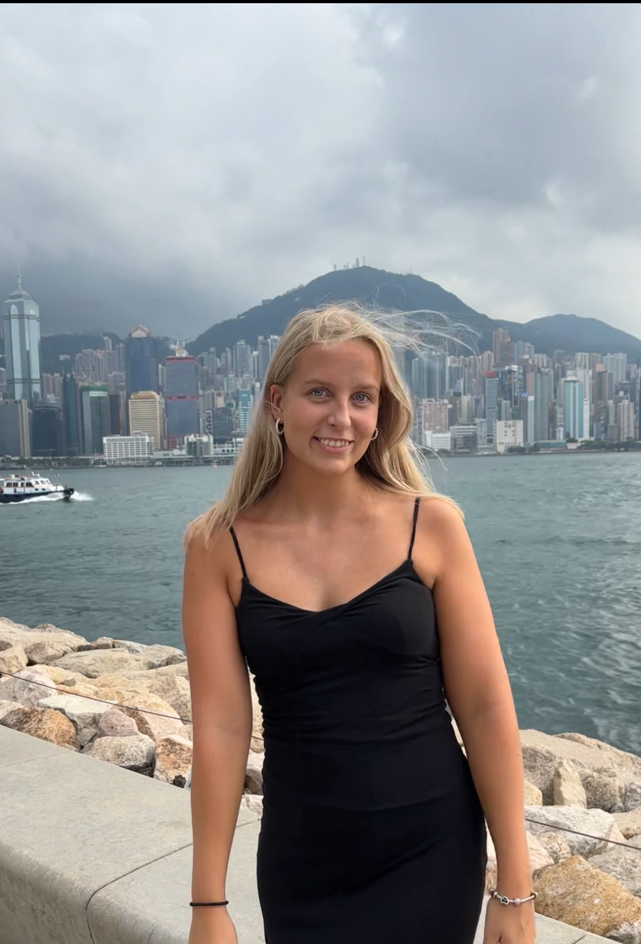
Reetta Kuusisto
Hello!
My name is Reetta and my major is health science (3rd year). I'm from Åbo/Turku and I like traveling, swimming and meeting new people. I have been on exchange in Hong Kong. A funny fact about me is that I can walk with my hands.
Instagram: @reettakuusisto

Slide 7
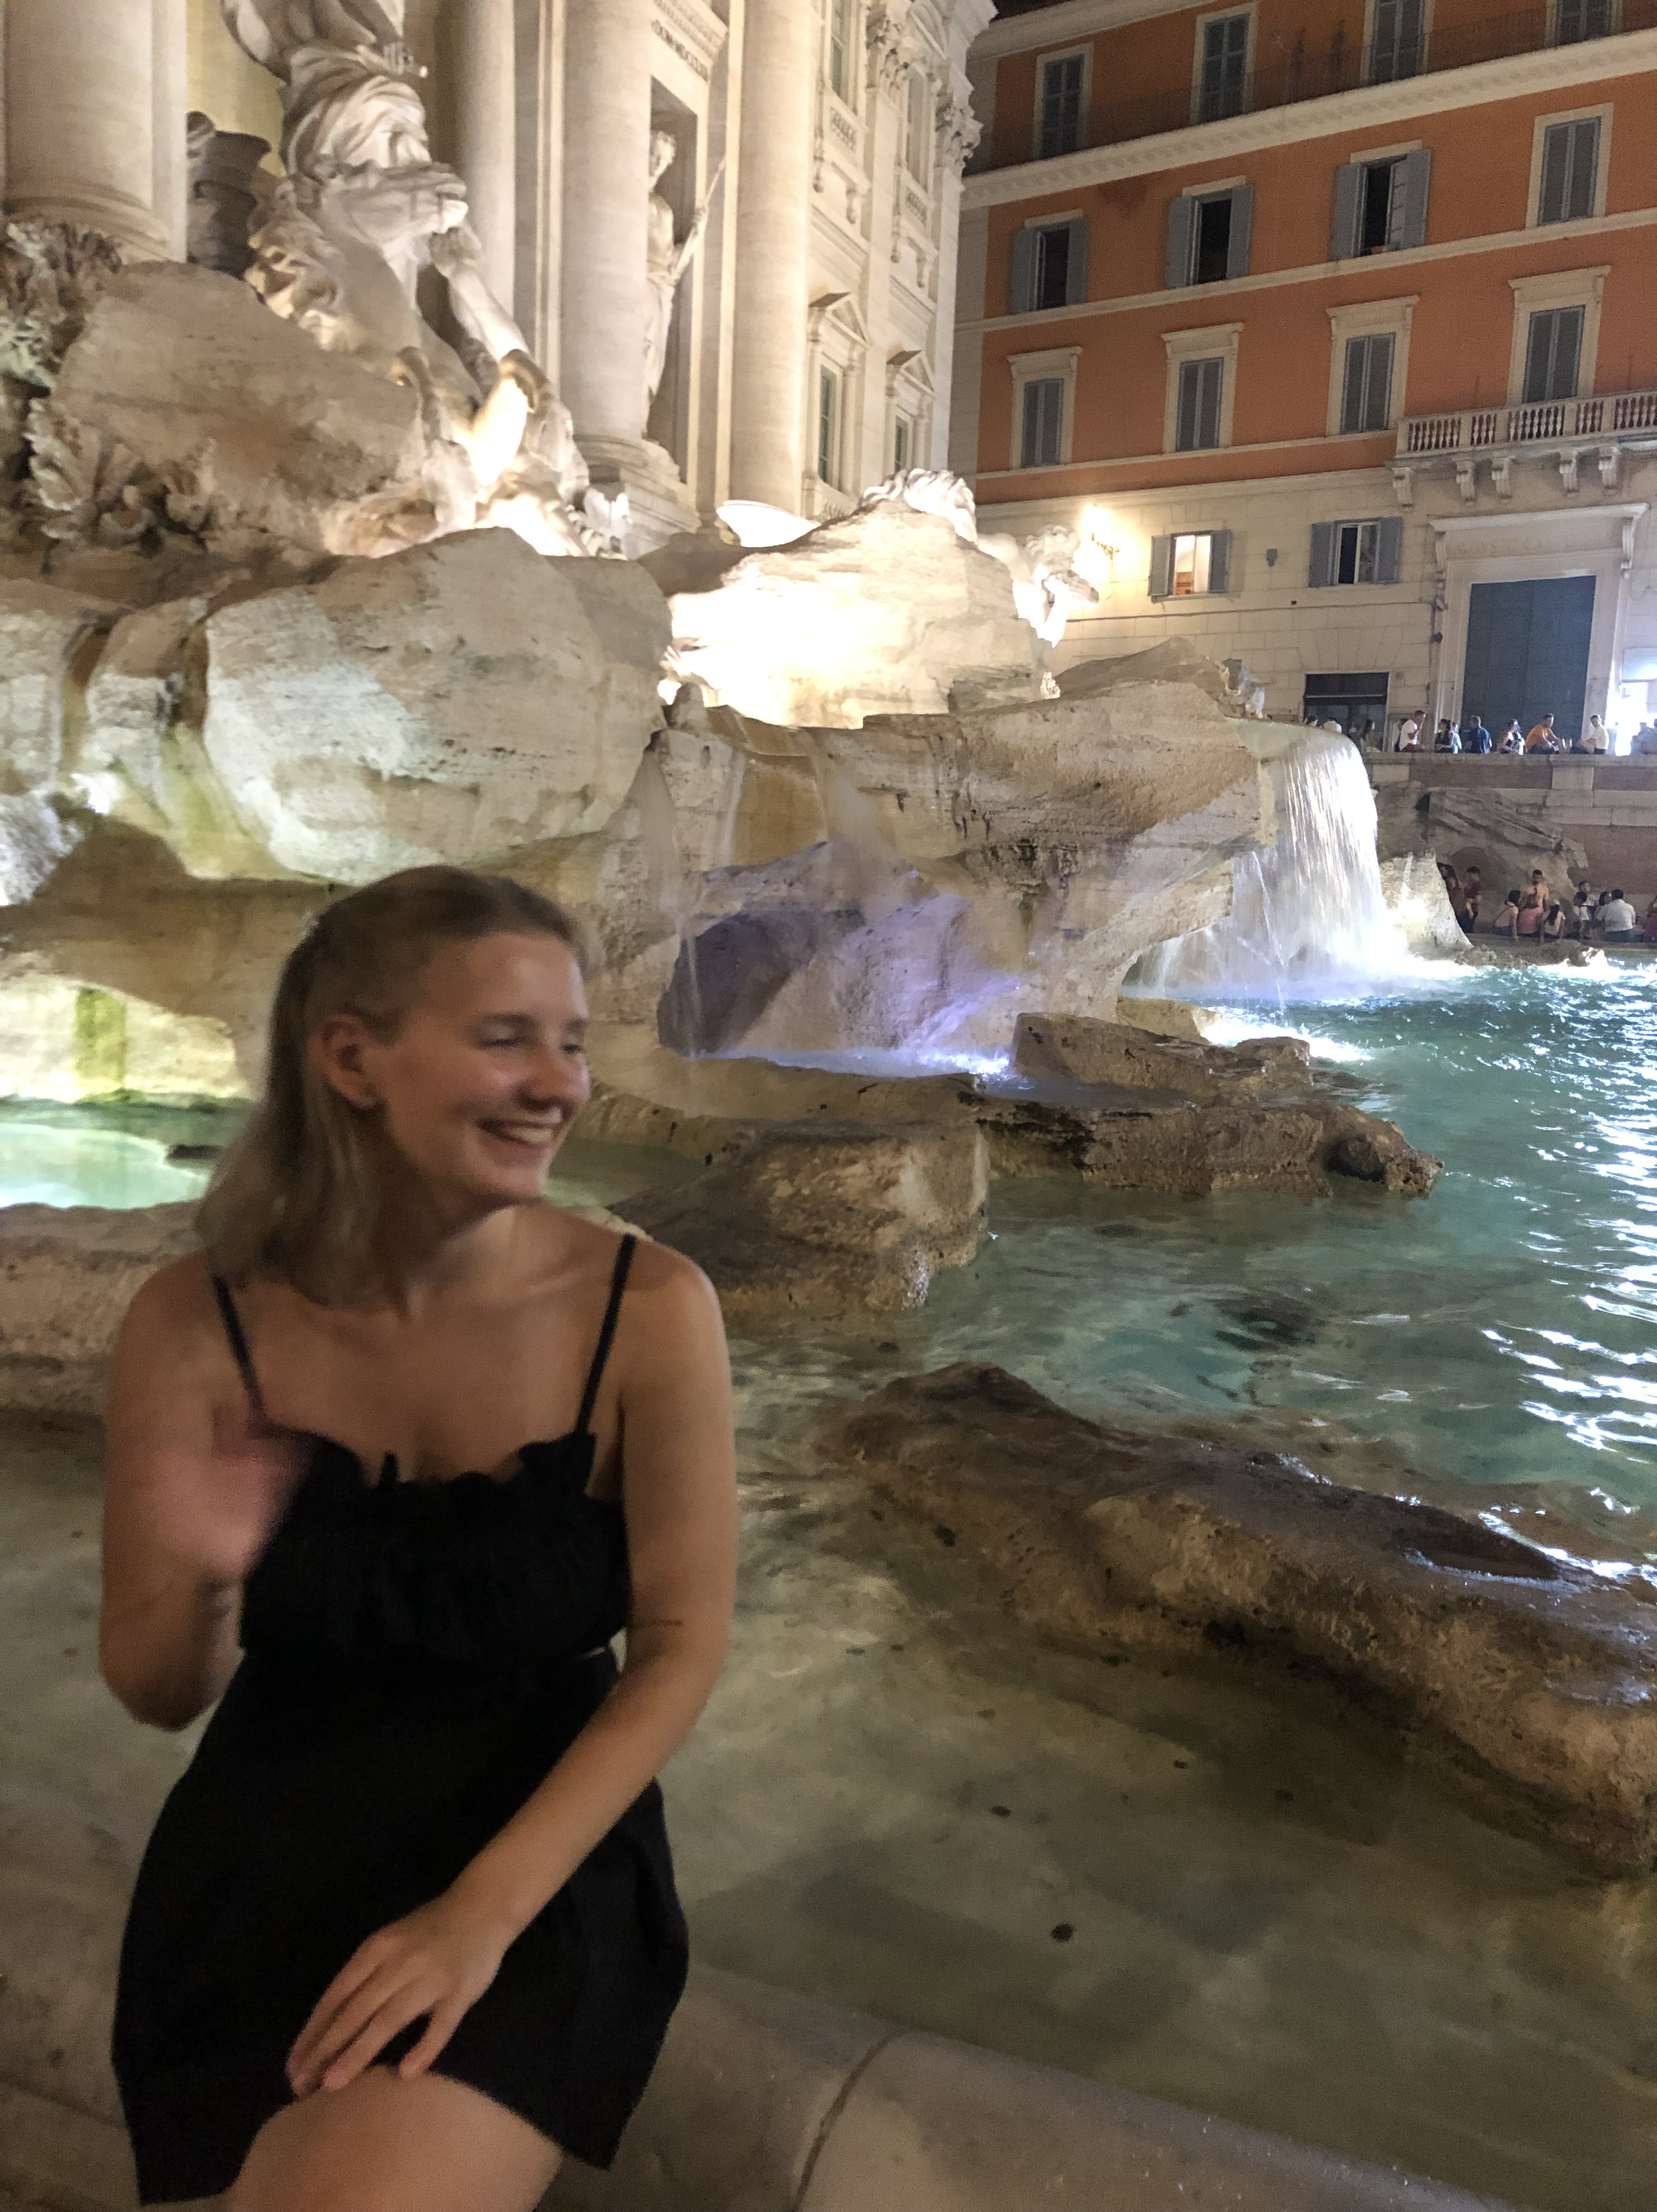
Julia Marttila
Hello!
My name is Julia, and I'm 21-years old. I'm studying to become a class teacher and am currently in my 1st year. I've lived in Vaasa for about 11 years and mainly speak Swedish. Last year I travelled through South-East Asia and had a lovely time in Japan, Vietnam, Thailand, Indonesia and South Korea.
In my spare time, I like to read books and dance. My favorite authors right now are Ana Huang and Lauren Asher.
I'm looking forward to meeting you all!
You can contact me on Instagram: _juliamarttila

