Slide 1
Information for new degree students
Faculty of Science and Engineering (FNT)
Master’s degree programme in Sustainable Chemical and Process Engineering
Double degree programme Exellence in Analytical Chemistry (EACH)

Slide 2
The Faculty
Faculty council (governing body)
Dean Patrik Henelius (chairs the council)
Faculty Office
  In the Axelia building (third floor), Biskopsgatan 8

Slide 3
Student affairs personnel at the Faculty office
  Study Advisors
  Simon Berg
  Jessica Lindroos
  Kerstin Fagerström
  Jonas Sandberg (in Vasa)
  fnt-studieradgivare@abo.fi
  Student Affairs Officers
  Mary-Ann Hamberg-Ahola
  Maria Hertell-Jalava
  Academic Affairs coordinator
  Heidi Karlsson

Slide 4
Master’s programmes
Master’s Degree Programme in Sustainable Chemical and Process Engineering
Double degree programme Exellence in Analytical Chemistry (EACH)
Other master’s degree programmes at the Faculty
IT: Master’s Degree Programme in Information Technology + three double degree programmes (ESIGELEC, INSA Rennes and NISS)
Biosciences: Master’s degree programme in Biomedical Imaging

Slide 5
Major subjects
The Master’s degree Programme in Sustainable Chemical
And Process Engineering has three major subjects:
Process Chemistry
Process Systems Engineering
Natural Materials Technology

Slide 6
Credits
All courses are measured in credits (study points, ”sp”)
A credit unit corresponds to the European Credit Transfer System (ECTS)
A full time study load for an academic year is 60 credits (the master’s degree, which is 120 cr, can be completed in two years)

Slide 7
Academic year, semesters, periods
The Academic year starts 1.8 and ends 31.7
The Academic year is divided into two semesters: autumn and spring and four periods, two in each semester:
  Period I: weeks 36-43, autumn semester
  Period II: weeks 44-51, autumn semester
  Period III: weeks 2-11, spring semester
  Period IV: weeks 12-21, spring semester

Slide 8
Lecture hours at ÅAU
Lecture hours at ÅAU, if nothing else is mentioned, are:
8-10 = 8.15-9.45
10-12 = 10.15-11.45
13-15 = 13.30-15.00
15-17 = 15.15-16.45

Slide 9
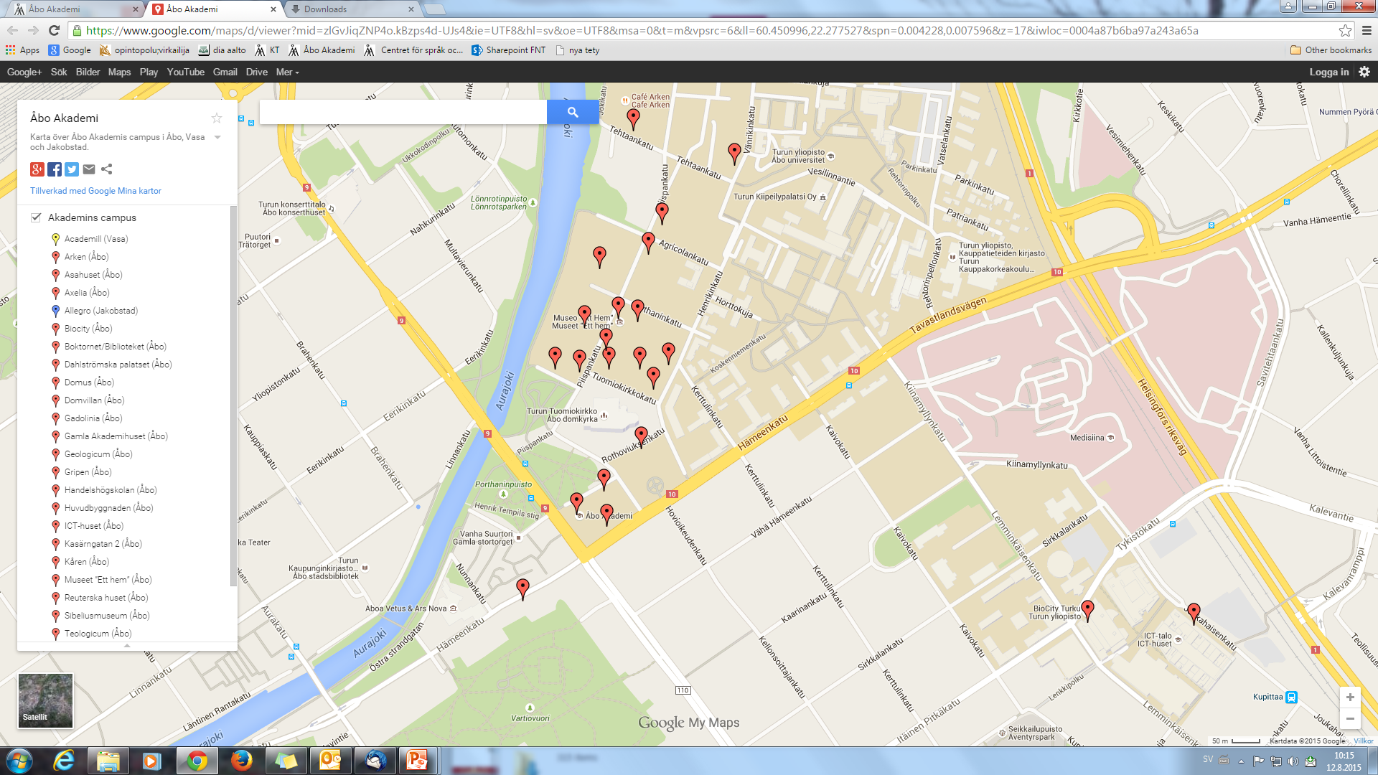
The campus area
ASA
Arken
Agora
Axelia
Gadolinia
Gripen
Kåren
Biocity

Slide 10
Activation of your computer rights
Information on how to activate your ÅAU-username can be found in Selfservice http://www.selfservice.abo.fi/
In order to activate your username electronically, you need Finnish bank codes, an electronic ID card or a mobile certificate.
Should you have problems, or if you do not have Finnish bank codes, please contact the Helpdesk:
Phone: (02) 215 4777
Email address: helpdesk@abo.fi
or visit the ASA building at Fänriksgatan 3 B, ground floor

Slide 11
Study planning tool
student.abo.fi
With the study planning tool you can
-create your study plan
-register to courses and exams
-generate a schedule
Mobile app Tuudo (iOS and Android)

Slide 12
The study guide
studiehandboken.abo.fi
The study guide contains
  -the study structure of your degree
  -course descriptions (click on the course name)
  -at the top of the course description you'll find the course version with the course schedule

Slide 13
Studyplanning-session in computer class
Will be arranged in September
Students will be notified about the date and time

Slide 14
Courses from the University of Turku (UTU)
If you want to take courses that are offered by the University of Turku (UTU) you need to apply for a flexible study right at www.joopas.fi
The credits are not yet transferred automatically from UTU to ÅAU
You must bring an UTU transcript to the Faculty Office in order to get the credits transferred.

Slide 15
Sources of information
The Orientation course for new international students 27.8-30.8.2019
https://www.abo.fi/en/study/already-in-2/orientation-course-for-new-international-degree-students-and-exchange-students/
Head of programme, Programme coordinator and teacher tutors:
- Anders Brink (Sustainable Chemical and Process Engineering, Head of programme)
- Frej Bjondahl (Sustainable Chemical and Process Engineering, programme coordinator, teacher tutor)
- Johan Bobacka (EACH, Head of programme)
Student Tutors: Himal Ghimire
The Faculty office in Axelia
  The Student Office and International Office in the Gripen building, Tavastgatan 13

Slide 16
Reminders
Enroll as present, deadline on Friday 30.8 at 15.00
https://www.abo.fi/en/study/already-in-2/information-for-new-degree-students-enrollment-as-presentabsent/
  Please read your Åbo Akademi email account (@abo.fi) regularly!

Slide 17
Good luck
with your studies!

Slide 18


